Slide 1
Communication And Culture

Slide 2
Table of contents
01
Body Language and Cultural
02
Characterestics Of Culture
03
Levels Of Uniqueness
04
Cultural Iceberg

Slide 3
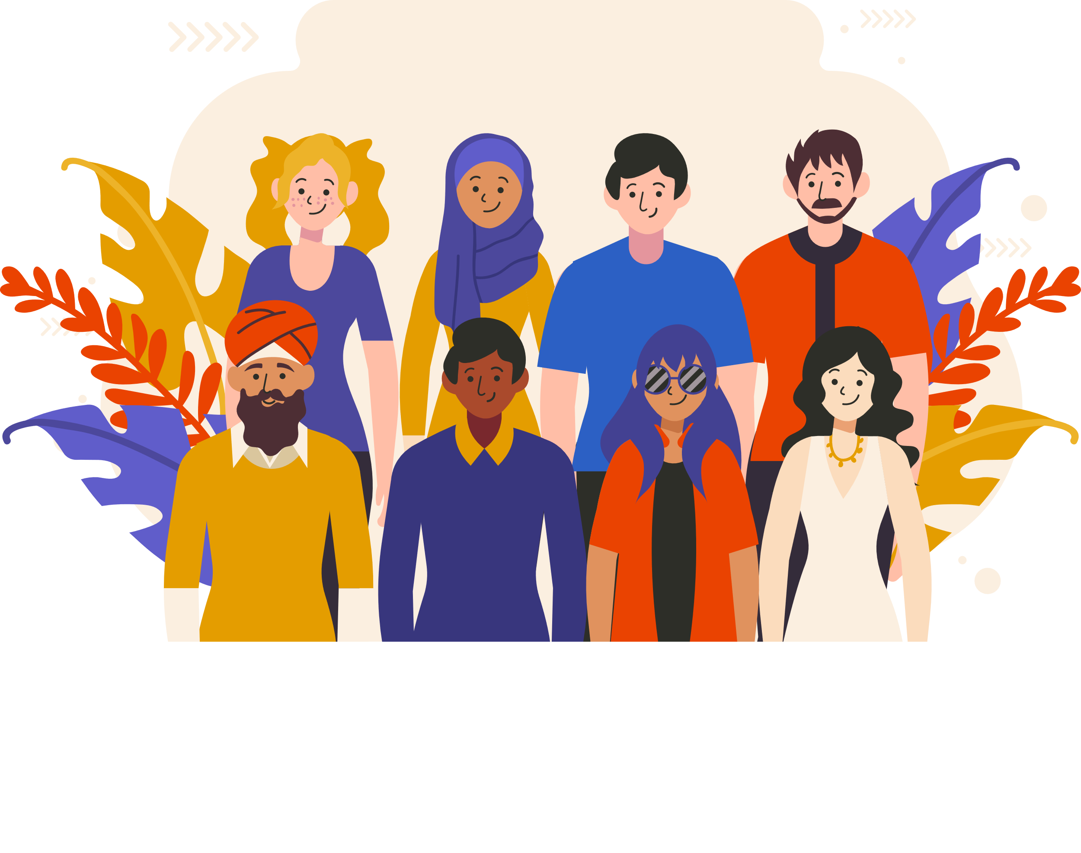
Culture diversity
“The Beuty Of The World Lies in The Diversity Of Its People”

Slide 4

Benefits
Culture provide people with ways of thinking, seeing, hearing and interpreting the world.

Slide 5
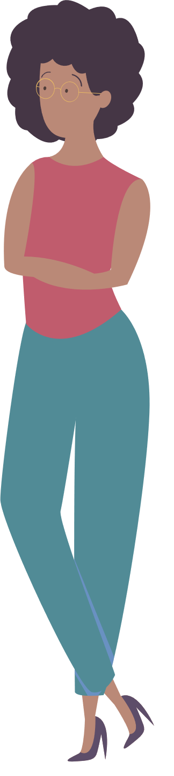
Misunderstanding
Cultural differences increase the likelihood of misunderstanding as well. If people speak different languages, the danger of bad translation is obvious. But even if people speak the same language, they may communicate in different ways.

Slide 6



Culture differences aspects
Body language differences
Personality differences
Behavior differences

Slide 7
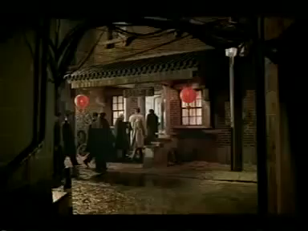
Misunderstanding

Slide 8
Body language can have very different meanings in different countries

Slide 9
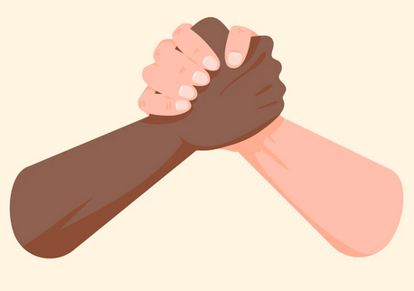



Examples
Hand shake
Eye contact
Sitting positions
Head moving

Slide 10

Characterestics of culture
1
Learned
2
Dynamic
Culture is
3
Based on Symbols
4
Integrated
5
Shared

Slide 11
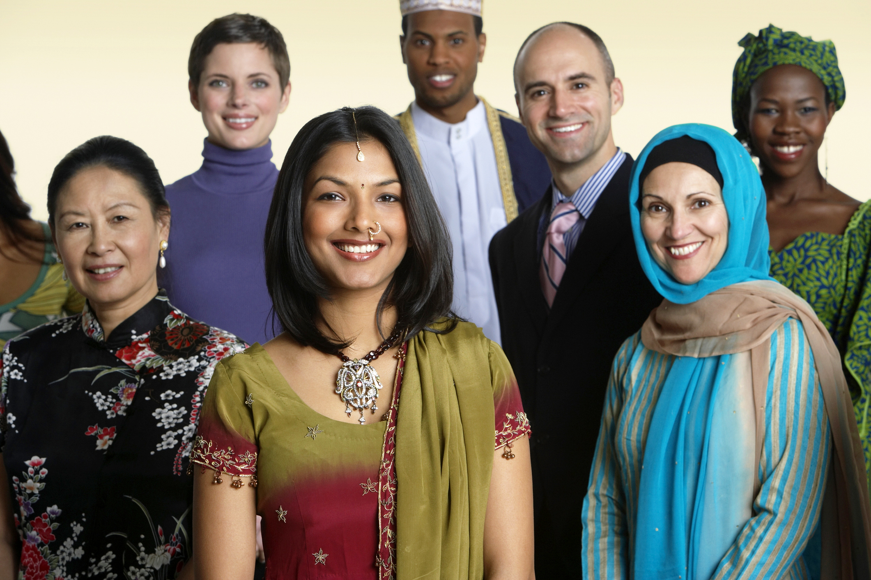

Slide 12
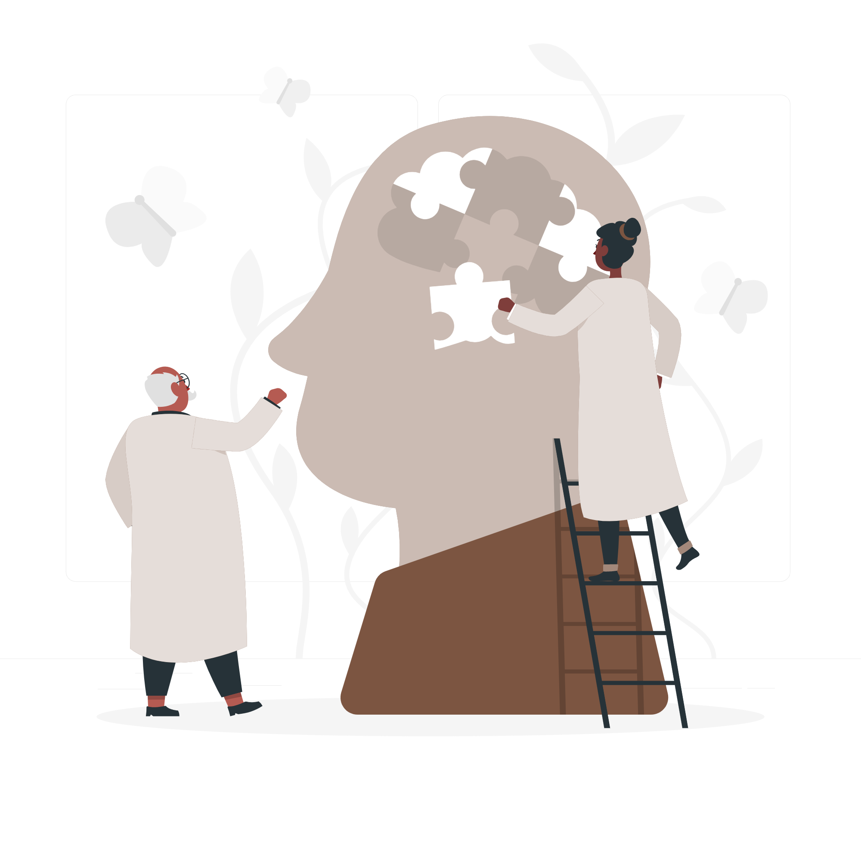
Culture
Rules
Traditions
Society members abide by
Distinguish one group of people from the other
Culture is like programming of the mind!

Slide 13
Hofstede
Three levels of uniqueness
in human mental programming

Slide 14
Levels
Human Nature
Personality
Culture
Inherited
Inherited & learned
Learned

Slide 15

Human Nature
Universal
Common between all humans

Slide 16

Culture
Group Specific
Specific to Certain Group or Category

Slide 17
Personality
Person Specific
Every Individual Human Has a Specific Personality

Slide 18

Culture Is like an Iceberg
What We See
The Actual
Iceberg

Slide 19
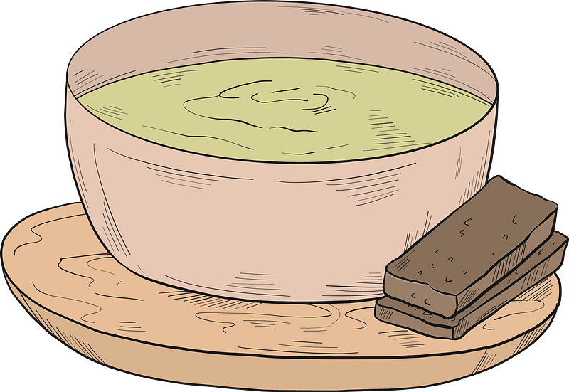
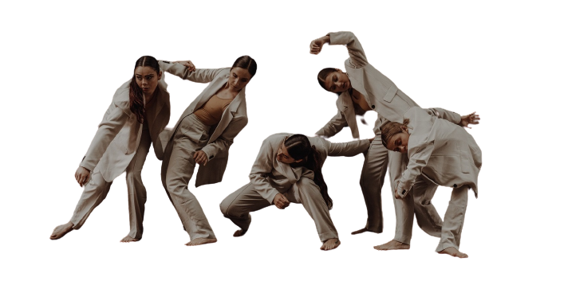

Above Waterline
Food
Behavior
Speaking
Arts
And the way people
eat
The way Person interacts with others
Include Dance,Music
And so on.
How People Speak.
And What People use to communicate

Slide 20
Below The Waterline
25%
18%
Rules
Traditions
20%
17%
Values and
Ethics
Beliefs

Slide 21
You cannot realize people's culture just by looking

Slide 22
Thanks!
Do you have any questions?

